Slide 1
ENOVIA V6 VPM Customization
Concepts and Implementation including examples

Slide 2
Learning Objectives
At the end of this module, you should be able to:
Describe the VPM Data Model
Describe how to modify attributes
Describe how to modify lifecycles
Describe the modification of user input and the GUI

Slide 3
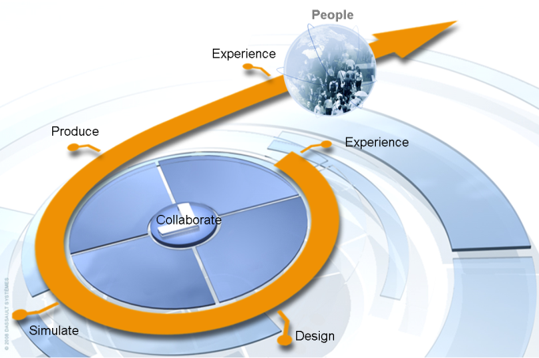
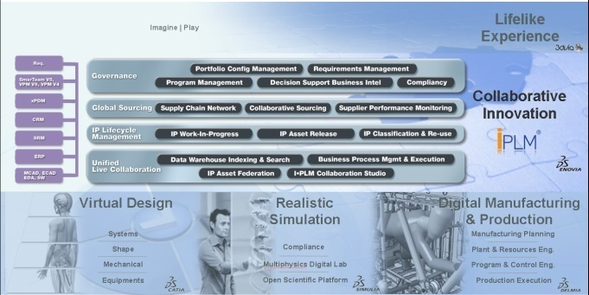
Fundamentals – One Single Architecture & Data Model
To accelerate innovation spiral, all data import, export & conversion should be eliminated
Share Design without local data duplication
Share Product Structure between Design, Simulate and Produce
ENOVIA V6 provides one single Architecture
To enable efficient cross-discipline collaboration, all applications
Same Configuration Management across all disciplines
Program Management covering all activities of a project
ENOVIA V6 relies on one single Data Model

Slide 4
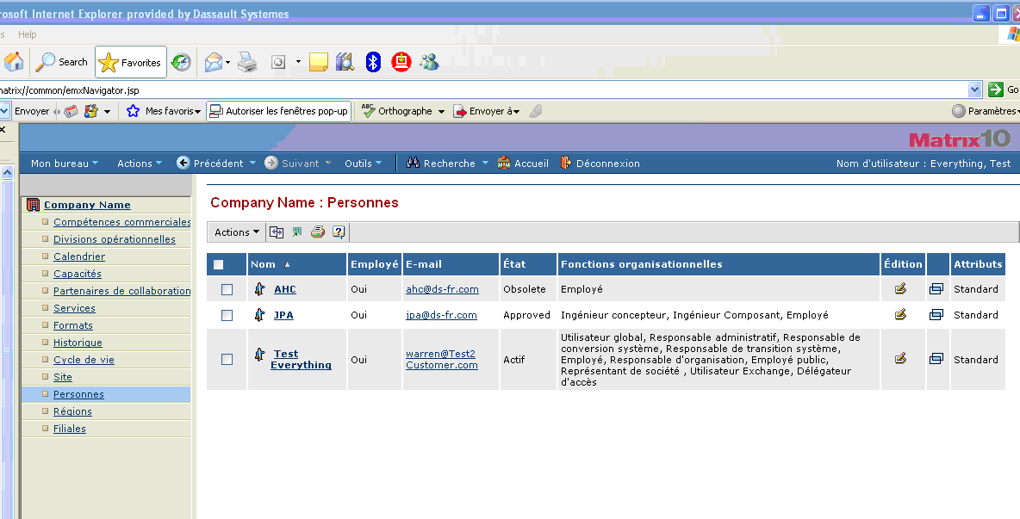
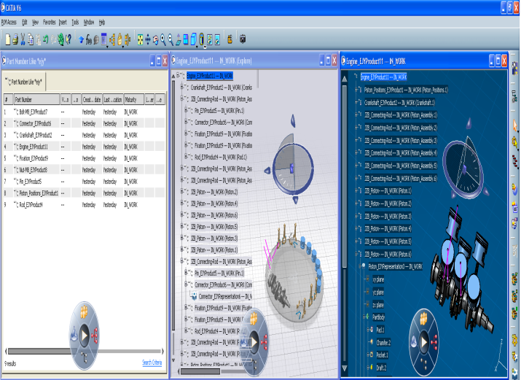
Fundamentals – Windows & Web User Interfaces
ENOVIA V6 provides infrastructure for Rich & Web applications
All data can be access in both environment
Requirement created in Web application can be used in CATIA environment
CATIA Product Structure can be used in Web environment
Authoring applications are rich or web, depending of their targeted users

Slide 5
V6 PLM Extensibility Model
Create or Customize Connectors
Customize PLM SOA User Experience
Create or Customize PLM Business Processes
Create or Customize Data and UI Models
Create or Customize Business Logic, and IP Modelers

Slide 6
Agenda
1
VPM Data Model Extension
1.1
Principles
1.2
Implementation
2
Object Attribute Access
2.1
Principles
2.2
Implementation
3
Life Cycle
3.1
Principles
3.2
Implementation
4
Customized User Input & Data Control
3.1
Principles
3.2
Implementation
5
Graphical User Interface
4.1
NLS / Alias, Object Naming, Icons, Colors & PLM Compass
4.2
Implementation

Slide 7




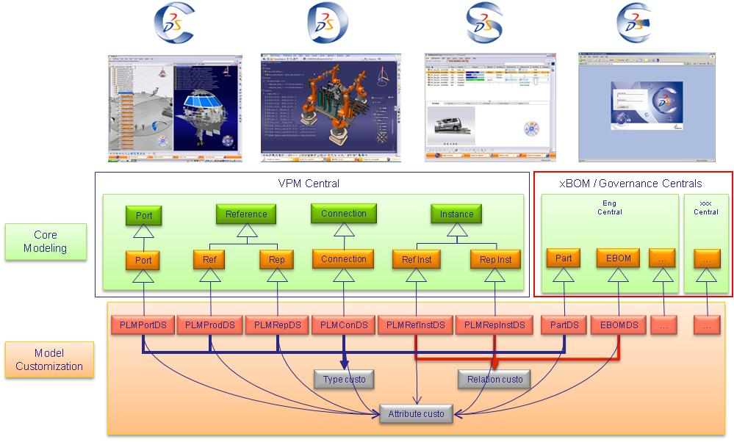
Fundamentals – Consistent Set of Modelers
From ENOVIA Infrastructure, a consistent set of modelers is delivered to support all applications
RFLP : Requirement, Functional, Logical, Physical, P&O
PPR : Product, Process, Resources, P&O
PCS/R : Product, Context, Scenario, Result, P&O
X-BOM, Multi CAD,Requirement, Program, Sourcing, Supplier, Library, P&O
Each modeler customization is stored in ENOVIA within objects called “type”, “relation” and “attribute”

Slide 8
VPM Data Model Extension - Principles
Modelers are a set of type, attributes, relations, behaviors and security definition
VPM modelers uses:
A list of types
Reference
Instance
RepReference
RepInstance
Connection
Port
A list of PLM Core Relations
Aggregation
Instance
Relation
A list of PLM Core Attributes
Associated behaviors
QEOpS (Query / Expand / Open / Save)
CrUD (Create / Update / Delete)
PLM Management (Lock / Maturity / Versioning / …)
Reference
PLM Core Objects & Relations
Reference
« Instance
link»
Instance
« Aggregates »
RepInstance
« Instance
link»
RepReference
Port
Connection

Slide 9
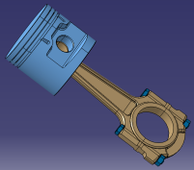
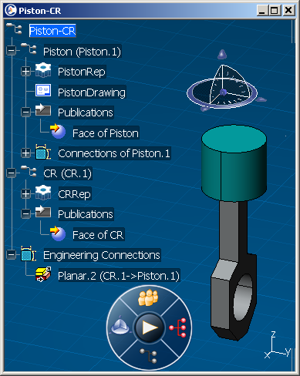
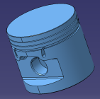
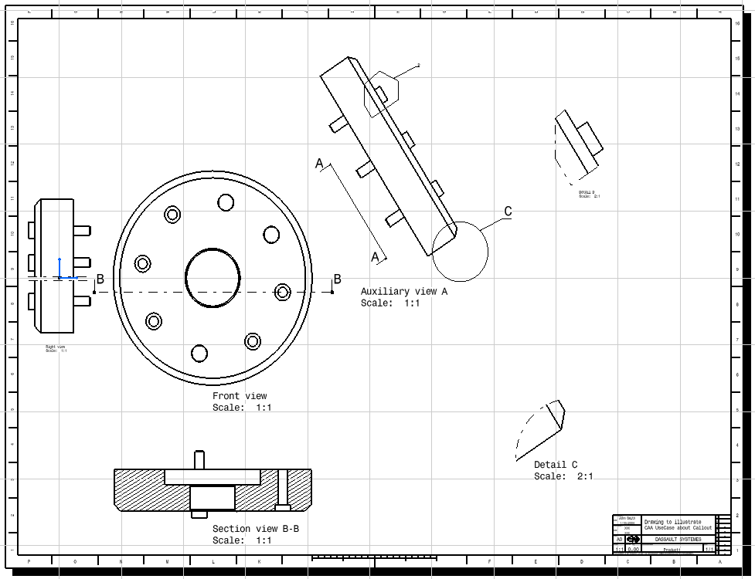
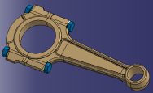
« Product Structure » Illustration
Piston-CR
Piston.1
Piston
PistonRep.1
Face of
Piston
PistonRep
PistonDrawing.1
CR.1
PistonDrawing
CR
CRRep.1
Eng. Cnx.
CRRep
Face of
CR

Slide 10
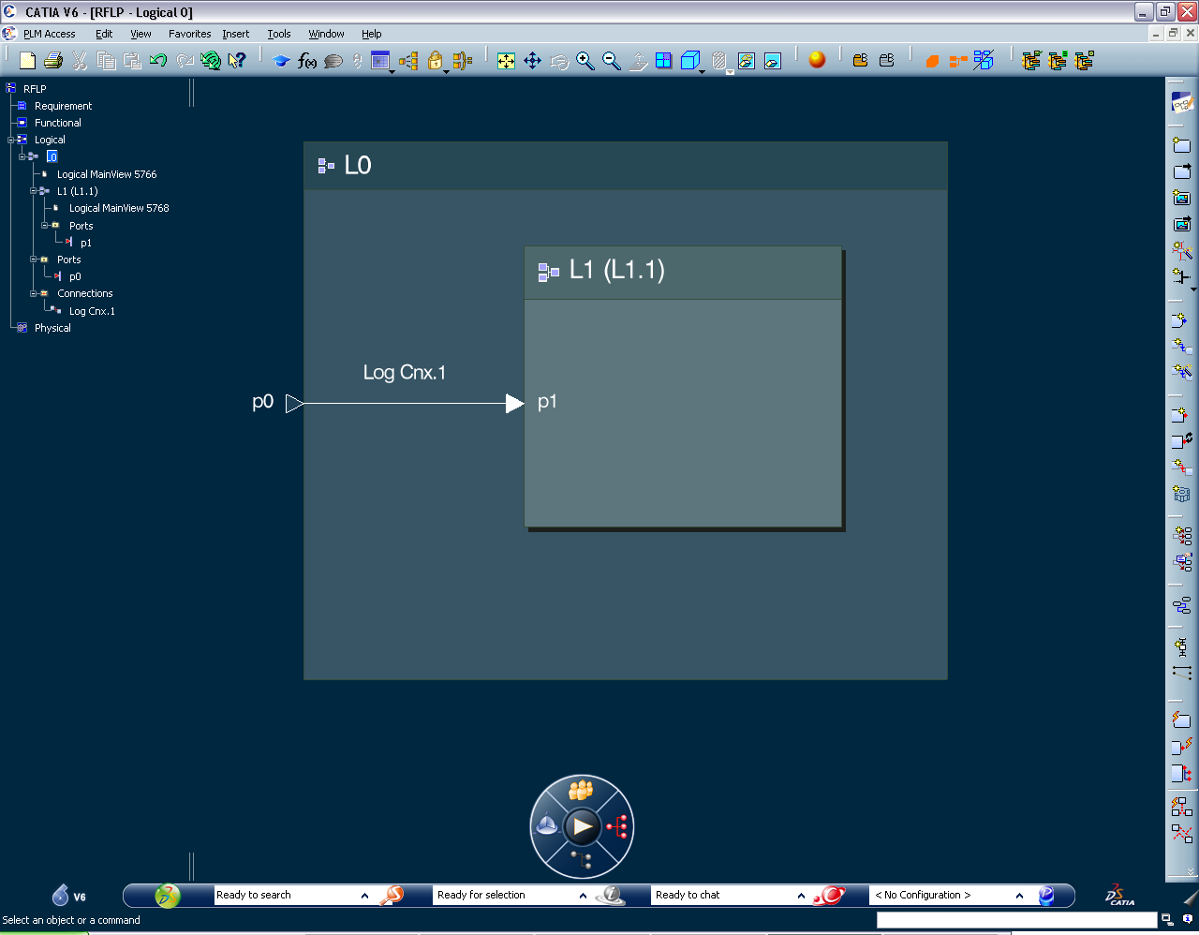

« Logical » Illustration
Logical editor view
ENOVIA V6 Model
L0
P0
LogCnx.1
L1.1
L1
P1
L1 2DRep.1
L1 2D Rep
L0 2DRep.1
L0 2D Rep

Slide 11
Agenda
1
VPM Data Model Extension
1.1
Principles
1.2
Implementation
2
Object Attribute Access
2.1
Principles
2.2
Implementation
3
Life Cycle
3.1
Principles
3.2
Implementation
4
Customized User Input & Data Control
3.1
Principles
3.2
Implementation
5
Graphical User Interface
4.1
NLS / Alias, Object Naming, Icons, Colors & PLM Compass
4.2
Implementation

Slide 12




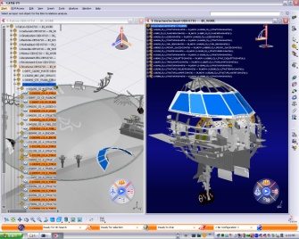
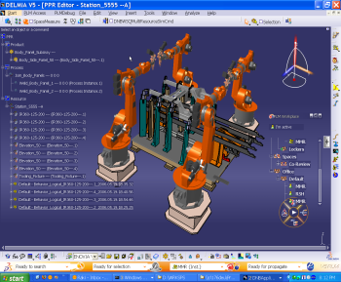
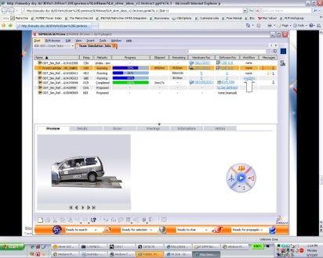
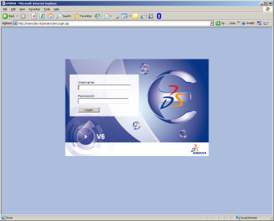
VPM Data Model Extension - Implementation
VPM application modelers derivation
VPM Central
xBOM / Governance Centrals
Port
Reference
Connection
Instance
Eng
Central
xxx Central
Core Modeling
Port
Ref
Rep
Connection
Ref Inst
Rep Inst
Part
EBOM
…
…
PLMPortDS
PLMProdDS
PLMRepDS
PLMConDS
PLMRefInstDS
PLMRepInstDS
PartDS
EBOMDS
…
…
Model Customization
Type custo
Relation custo
Attribute custo

Slide 13
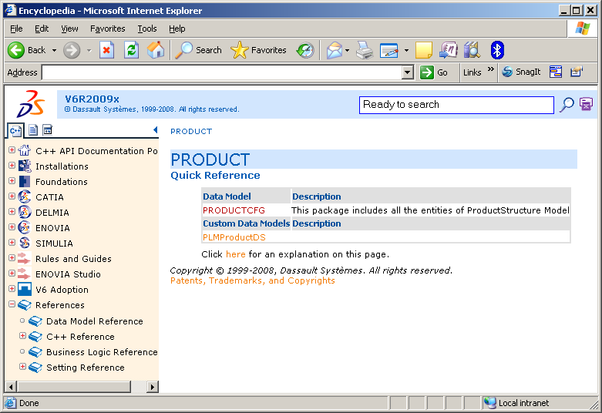
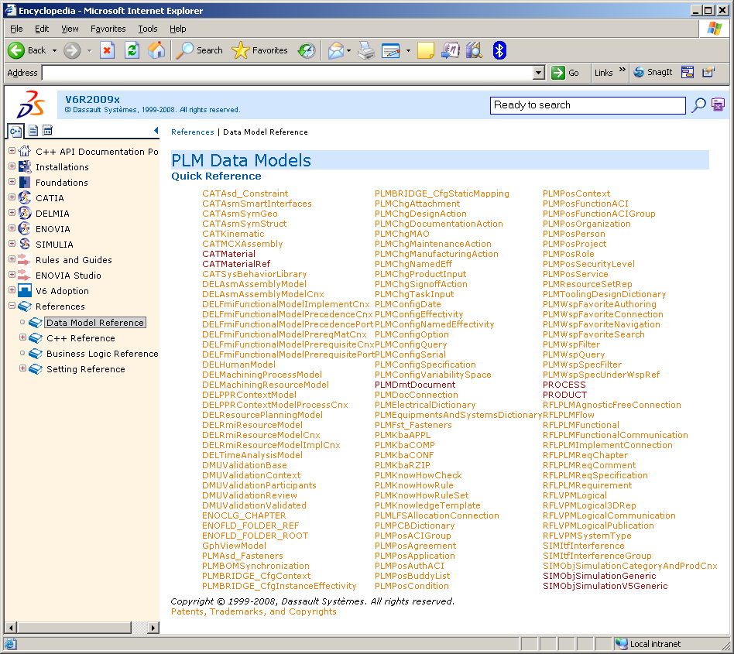
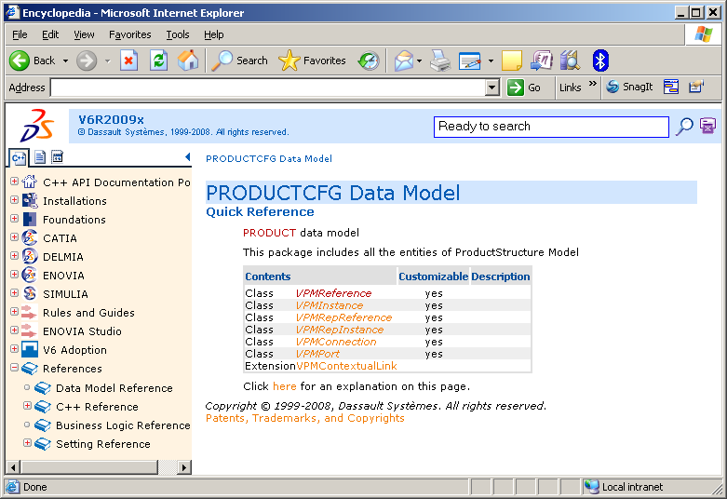
VPM Data Model Extension - Implementation
Customizable modelers:
<install CAA path>\CAADoc\Doc\online\DSDoc.htm

Slide 14
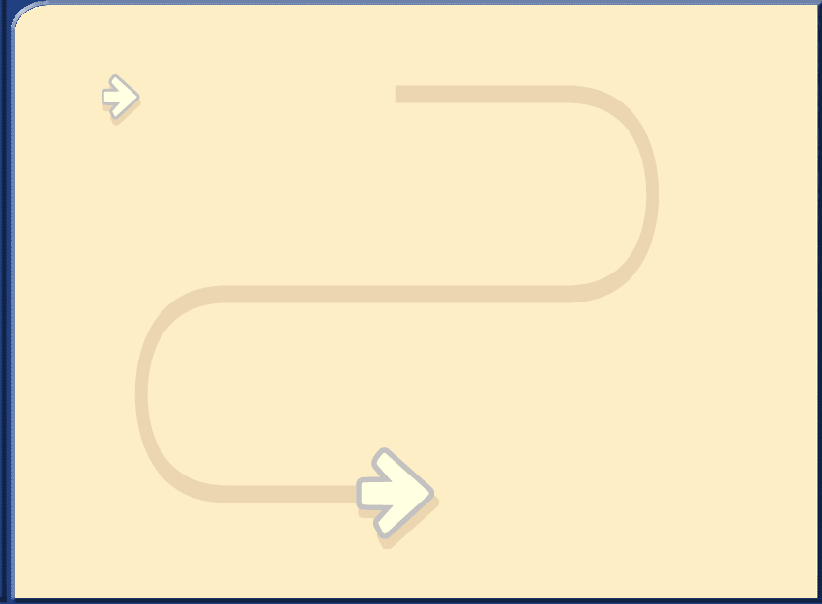
VPM Data Model Extension - Implementation
Step-by-Step
Customization Environment Development
Define Settings
1
2
3
Package Customization
Define Customization
4
5
Include Customization intoPLMEnvironment
6
Deploy Customization

Slide 15
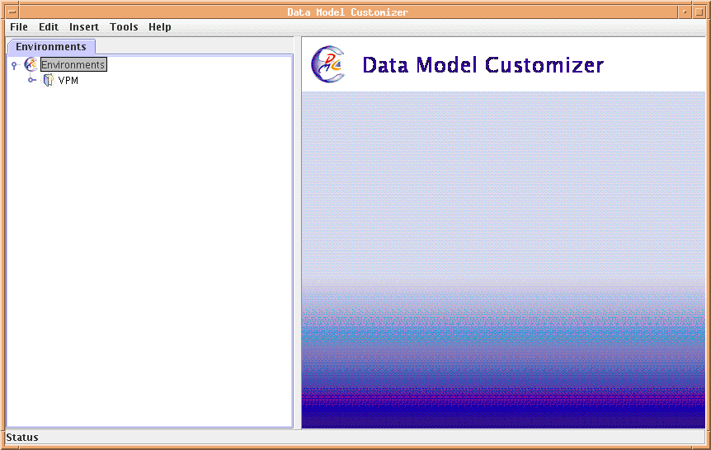
VPM Data Model Extension - Implementation
1
Customization Environment Development
Runs on the server side
UNIX: “DMCTools.sh”
WINDOWS: “DMCTools.bat”

Slide 16
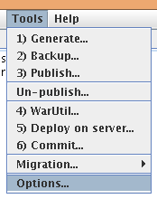
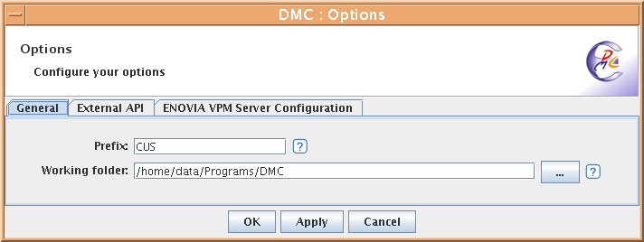
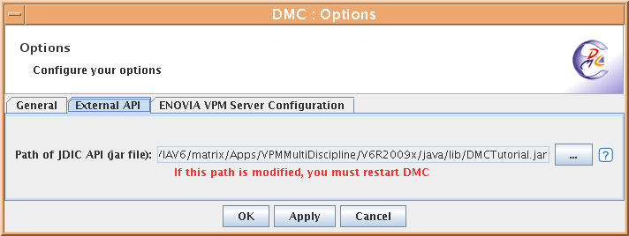
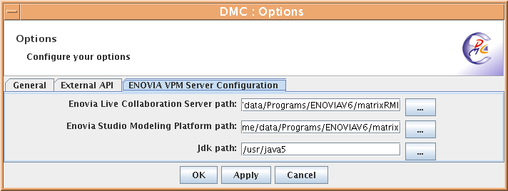
VPM Data Model Extension - Implementation
2
Define Settings
General
Define the prefix of the modeler
customizations
Goal is to distinguish DS from
customer objects & attributes
Rule: keep the same prefix for all
objects of the same company
Define the “Working Folder”
External API
Provide the additional capability to use
the “Help>How to...” command
ENOVIA VPM Server Configuration
Define the installation path of:
Enovia Live Collaboration Server path
Enovia Studio Modeling Platform path
JDK path

Slide 17
VPM Data Model Extension - Implementation
3
Define Customization
Package / objects derivation
Product, Material, Simulation, Document, Process, Folder, …
User defined attributes
Attribute Name
Simple Type
BOOLEAN
STRING
DOUBLE
INTEGER
DATE
ENUMERATION
Complex Type
SET & LIST (multi-valuated attribute with / without value duplication)
Additional Properties Flags
Mandatory / Optional (mandatory flag not published to DB Data Model)
Free / User (load upon mask access definition)
Expose in 3DXML for Review
“Reset Value" option for cloning and versioning operations
Default value
Max length for “string” type

Slide 18
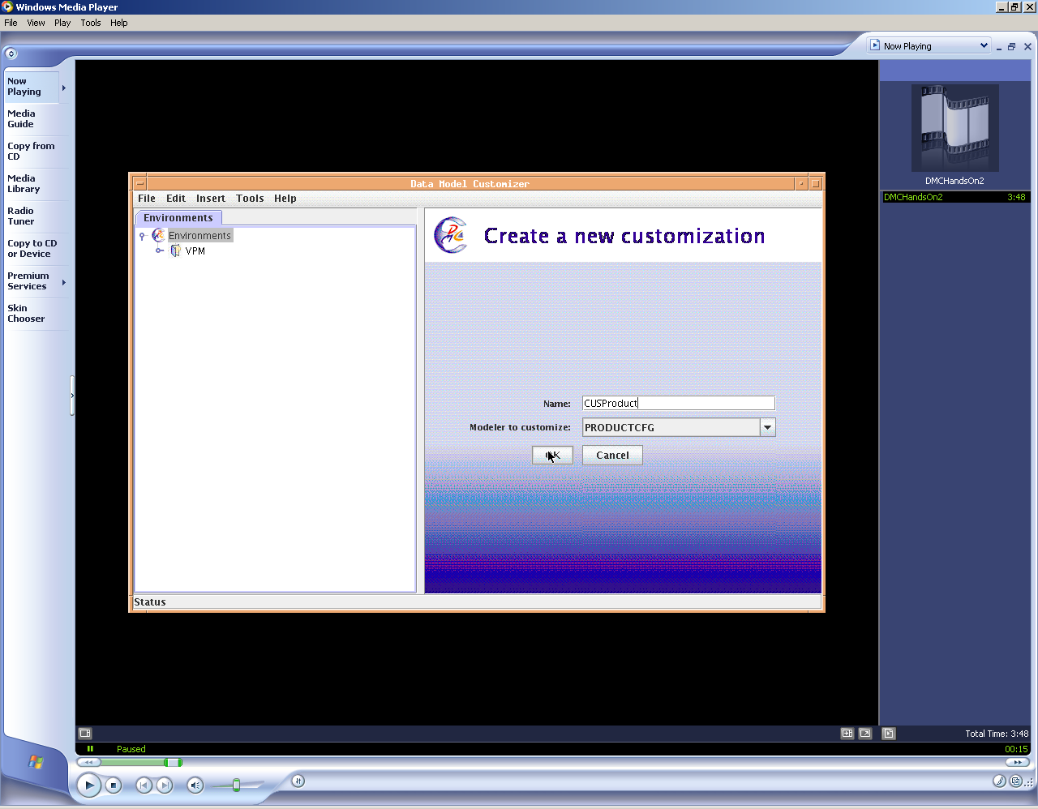
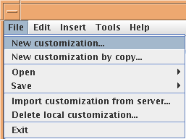
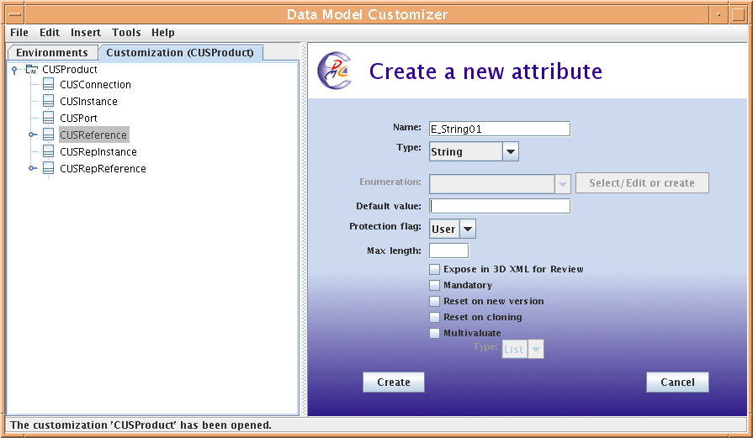
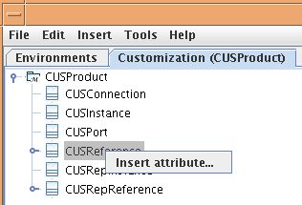
VPM Data Model Extension - Implementation
3
Define Customization

Slide 19
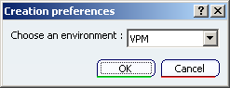
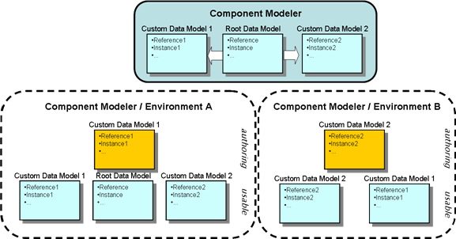
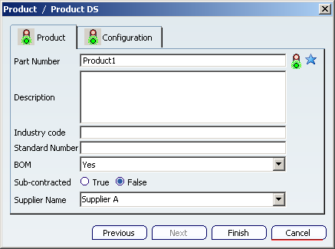
VPM Data Model Extension - Implementation
4
Include Customization into PLM Environment
What is PLM Environment ?
The goal of the PLM environments is to organize the customized data models so that each discipline gets an adapted view on the data models. In other words: each discipline can limits the creation / query actions on a predefined list of data models.

Slide 20
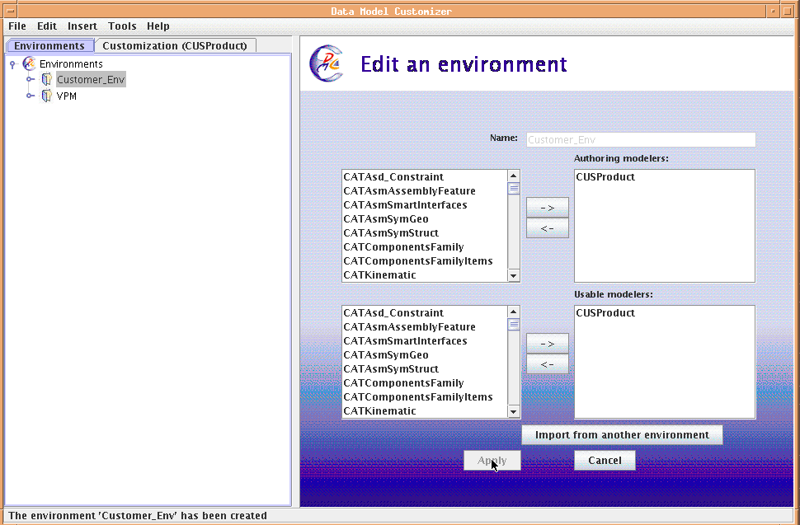
VPM Data Model Extension - Implementation
4
Include Customization into PLM Environment
Create a new PLM Environment
Use existing PLM Environment

Slide 21
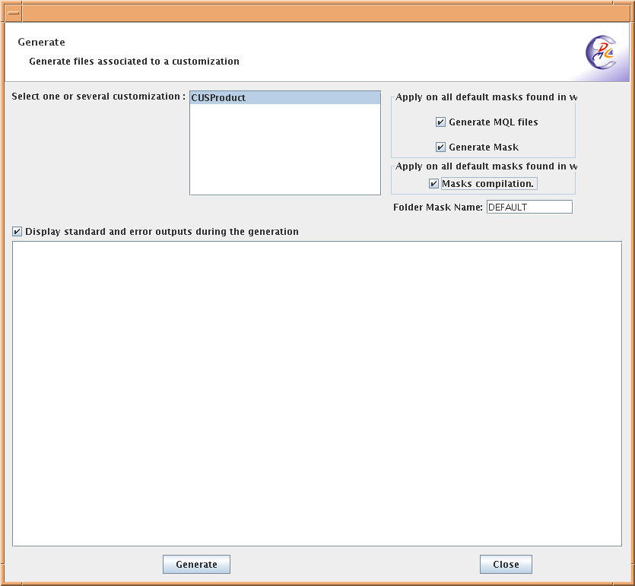
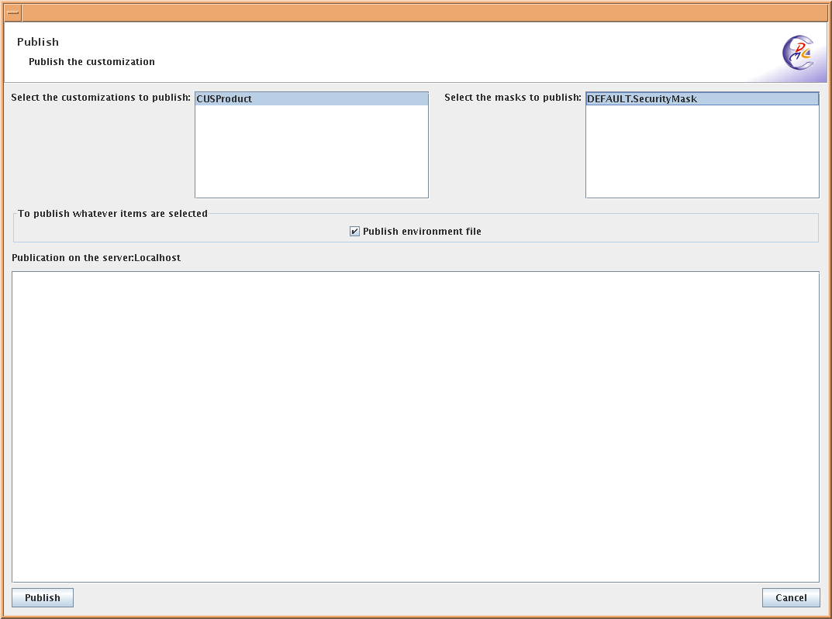
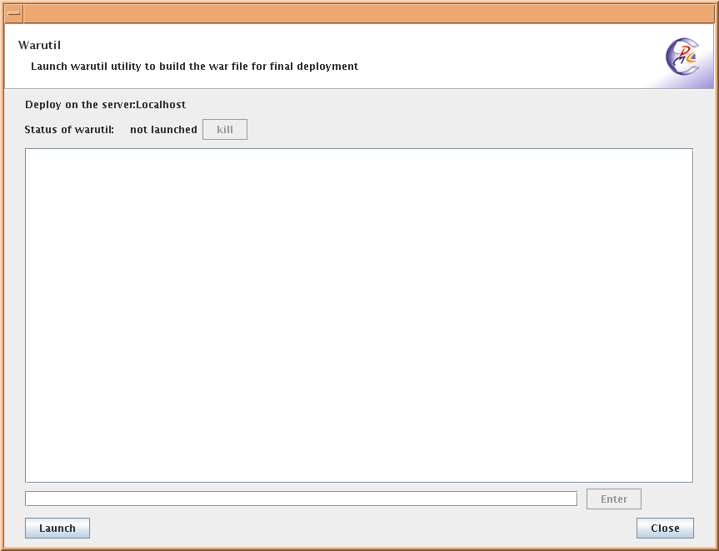
VPM Data Model Extension - Implementation
5
Package Customization - 3 steps
“Generate”
Generate MQL files
Generate & Compile Mask
“Publish”
Transfer on « STAGING »
Customization definition
Mask
Environment file
“WarUtil”
Create the “.war/.ear” files
1. Generate
2. Publish
3. WarUtility

Slide 22
VPM Data Model Extension - Implementation
6
Rollout Customization
Into DB
Execute MQL statements
Onto the application server
Deploy the “.war” or “.ear” file
ENOVIAV6 Installation
ENOVIA Live Collaboration Server (matrixRMI)
« DMCmql »
« distrib »
.mql
.ear
.war
Use “MQL” command line
Use Application Server specific tool
DB2 / Oracle
WebSphere / Tomcat

Slide 23
Agenda
1
VPM Data Model Extension
1.1
Principles
1.2
Implementation
2
Object Attribute Access
2.1
Principles
2.2
Implementation
3
Life Cycle
3.1
Principles
3.2
Implementation
4
Customized User Input & Data Control
3.1
Principles
3.2
Implementation
5
Graphical User Interface
4.1
NLS / Alias, Object Naming, Icons, Colors & PLM Compass
4.2
Implementation

Slide 24
Object Attribute Access - Principles
On PLM objects, the object attribute access is governed by masks
A mask defines:
The attribute visibility on operations such as :
Create & Edit
Search, Result & Display
Whether the attribute is modifiable or not
Default value or range of values for an attribute
A mask can be define for five operations:
Creation
Query
Read
Write
Tree

Slide 25
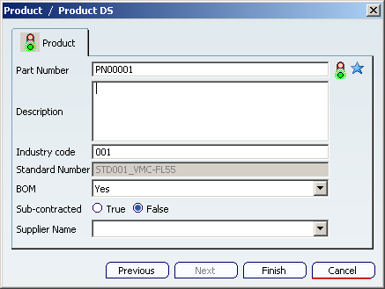
Object Attribute Access - Principles
“Creation”
Uniqueness Key attributes have star icons
Mandatory attributes have "traffic light" icons
Creation mask
Default value filled in
Read-only attributes are grayed
Authorized values
Help values

Slide 26
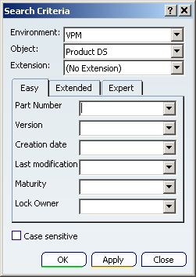
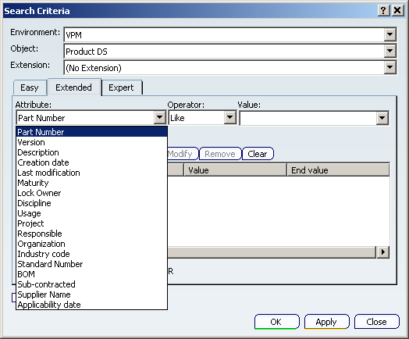
Object Attribute Access - Principles
“Query”
EZQuery mask
Query mask

Slide 27
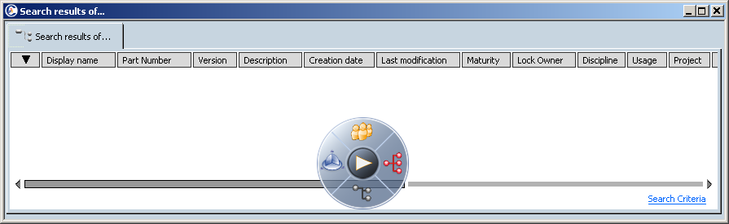
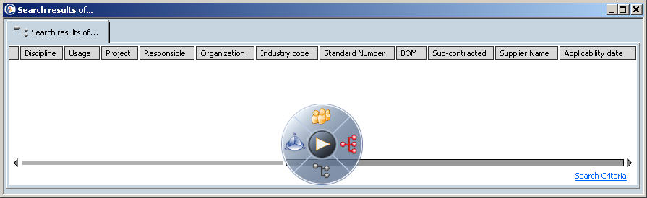
Object Attribute Access - Principles
“Read”
“Read” mask

Slide 28
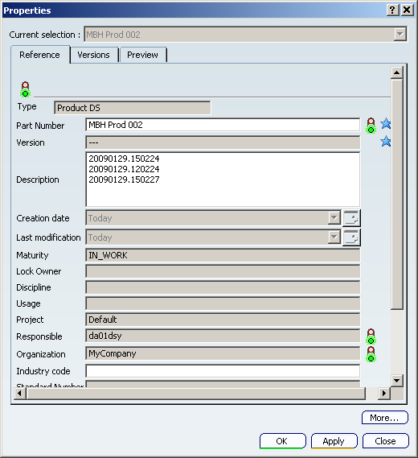
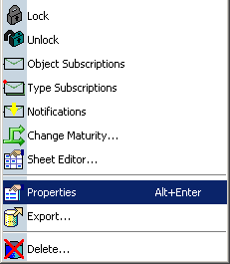
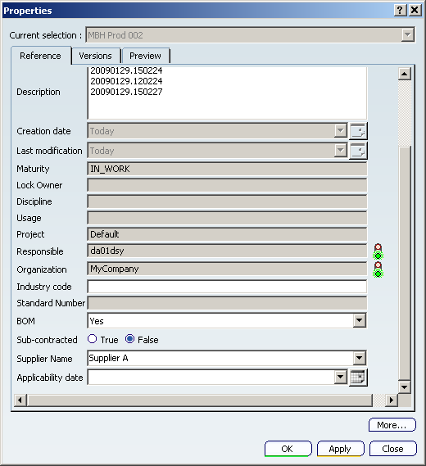
Object Attribute Access - Principles
“Write”
“Write” mask
PN00001
“Read” mask

Slide 29
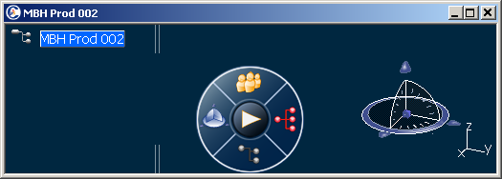
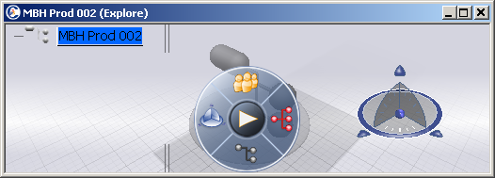
Object Attribute Access - Principles
“Tree”
PN00001
PN00001
“Tree” mask

Slide 30
Object Attribute Access - Principles
Mask has to be defined for each customized PLM objects

Slide 31


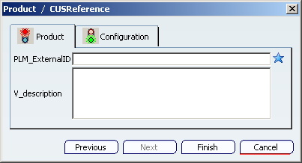
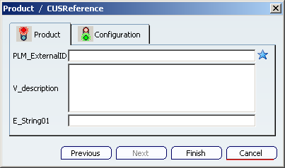
Object Attribute Access - Principles
Different Masks for the same PLM object can be assigned to users
Person
Organization
Role
Project
A combination of them (i.e. « security context »)
Persons
Mr.Doe
Mrs.Smith
Is Assigned To
Is Assigned To

Slide 32
Agenda
1
VPM Data Model Extension
1.1
Principles
1.2
Implementation
2
Object Attribute Access
2.1
Principles
2.2
Implementation
3
Life Cycle
3.1
Principles
3.2
Implementation
4
Customized User Input & Data Control
3.1
Principles
3.2
Implementation
5
Graphical User Interface
4.1
NLS / Alias, Object Naming, Icons, Colors & PLM Compass
4.2
Implementation

Slide 33
Object Attribute Access - Implementation
Step-by-Step
Customization Environment Development
Generate Mask
1
2
Compile Mask
4
3
5
Edit Mask
Package Mask
6
Deploy Mask

Slide 34
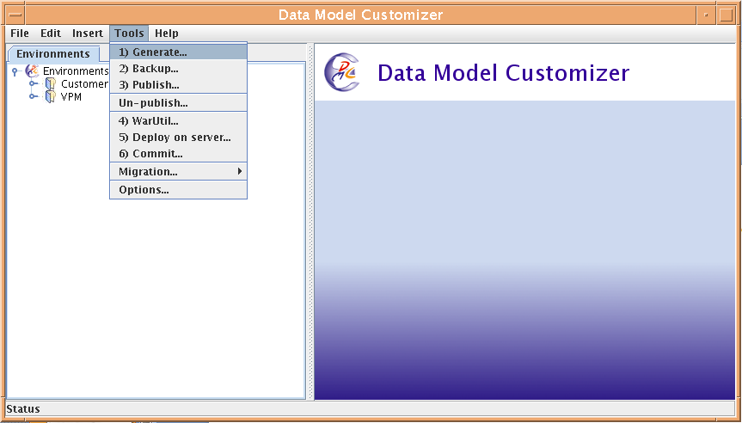
Object Attribute Access - Implementation
1
Customization Environment Development
Runs on the server side
UNIX: “DMCTools.sh”
WINDOWS: “DMCTools.bat”

Slide 35
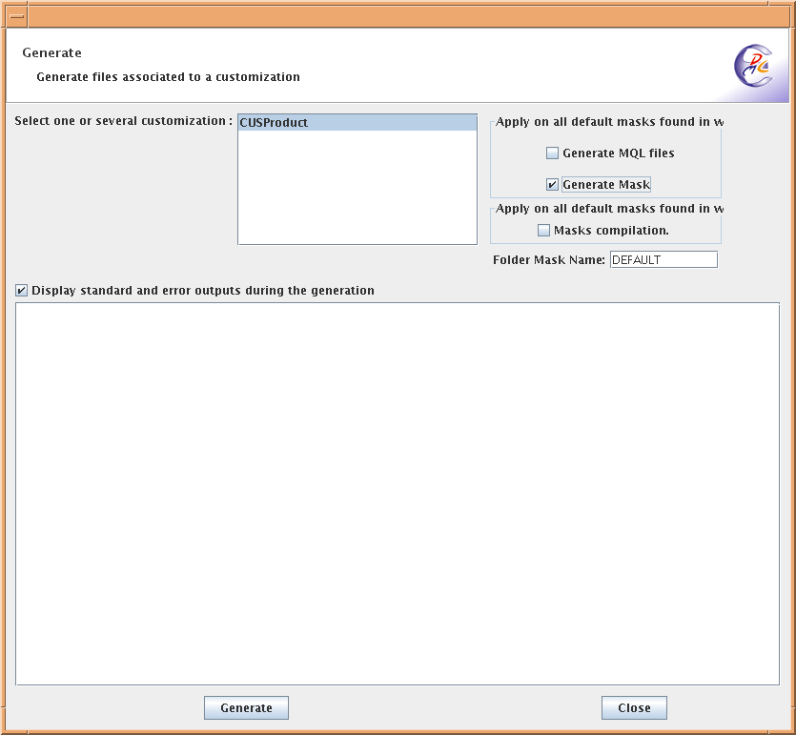
Object Attribute Access - Implementation
2
Generate Mask
This function provides the default mask definition for each selected customized modelers.
2. Activate the generate option
1. Select customization for which
you want to generate a default mask
3. Provide the name of the mask file
(if the name is “DEFAULT” , all users get this mask
at login if no other mask has been assigned to them.
A “DEFAULT” mask has to be
generated for each new customization)

Slide 36
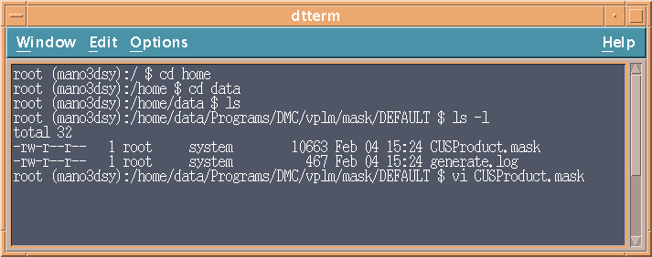



Object Attribute Access - Implementation
3
Edit Mask
Open the “.mask” files and edit it
Syntax file is available as header
1. Go into the mask directory
and edit the “.mask” file
Mask « Create » only
has 2 attributes now
2. On the « ENTITY CUSReference » …
3. … below the « Create » mask,
remove the attribute E_String01

Slide 37

Object Attribute Access - Implementation
4
Compile Mask
This operation provides the mask file for the runtime view
1. Activate the compilation option
2. Provide mask name to compile
(This name must correspond to existing mask name. See “Generate Mask”)

Slide 38

Object Attribute Access - Implementation
5
Package Mask - 2 steps
“Publish”
Transfer on « STAGING »
Mask only
“WarUtil”
Create the “.war/.ear” files
1. Publish
Select the mask file to publish
Uncheck the environment file publication
2. WarUtility

Slide 39
Object Attribute Access - Implementation
6
Rollout Mask
Into DB
Execute the MQL statement to assign a mask to a P&O “user”
Syntax: add command mask::<mask name> user <P&O user>;
<mask name> is the folder mask name
<P&O user> can be: person, role, organization, project, security context,…
For the “DEFAULT” mask, do not execute the above step
Onto the application server
Deploy the “.war” or “.ear” file

Slide 40
Agenda
1
VPM Data Model Extension
1.1
Principles
1.2
Implementation
2
Object Attribute Access
2.1
Principles
2.2
Implementation
3
Life Cycle
3.1
Principles
3.2
Implementation
4
Customized User Input & Data Control
3.1
Principles
3.2
Implementation
5
Graphical User Interface
4.1
NLS / Alias, Object Naming, Icons, Colors & PLM Compass
4.2
Implementation

Slide 41

Life Cycle - Principles
Life Cycle Management
PLM stands for Product Life cycle Management, meaning that products are managed during their whole lifetime as they go through different phases, from development to release. The following figure represents an example of a life cycle:

Slide 42

Life Cycle - Principles
Maturity Graph (1/2)
PLM component life cycle is modeled using a maturity graph. All the elements defined by such a graph are illustrated as follow:
A maturity graph is composed of:
“State”: “Work in Progress“, “Wait for Approval”, “Frozen, “Release”
“Transition”: possible change of the maturity of the data
“Behavior” or “Accesses”: each state canspecify a list of possible operations such as “Read”, “Write”, “Promote”, “Delete”, ... granted to users. These list can be conditioned with a filter.
“Guard” or“Signature”: it give authorization for the promotion of the data

Slide 43






Life Cycle - Principles
Maturity Graph (2/2)
The maturity graphis implemented in the policies (see P&O press)
…to get the list of grants
…to get the accesses and the filter
Edit one Lifecycle State…
Edit one grant…
…to modify signature definition
…to get the list of signatures
Edit one Transition…
Edit one signature…

Slide 44



PLM policy on V6R2009x – Default Lifecycle
Leader
Designer
Reviewer
MyProject = every data from current project
MyData = data owned by me
MyProject and MyData = data owned by me in current project only
Leader
Designer
Reviewer
Not deletable
Not versionable
Reject
Name of transition in
Business Modeler LCG
IN_WORK
Share
WAIT_APP
MyProject
Reject
KeepPrivate
Share
MyProject
Leader
Designer
Reviewer
Not modifiable
Leader
Designer
Reviewer
Not deletable
PRIVATE
SHARED
Downgrade
Maturity status of the PLM object
Current Project
MyProject
PLM Object is:
Roles
Any Project
MyProject and MyData
Not deletable
Team Leader
Not versionable
Designer
Not modifiable
Reviewer
Notes:
PRIVATE status:
Reviewer will never access any PRIVATE data.
Designer will only access his own data in the current project and will have all rights on them
Leader will access every PRIVATE data from current project and will have all rights on them
Policy: VPLM_SMB
Temp query bus VPLMtyp/PLMProductDS * * select name altowner1 altowner2
altowner1 = Organization
Altowner2 = Project
altowner1[<Organization>]

Slide 45
Agenda
1
VPM Data Model Extension
1.1
Principles
1.2
Implementation
2
Object Attribute Access
2.1
Principles
2.2
Implementation
3
Life Cycle
3.1
Principles
3.2
Implementation
4
Customized User Input & Data Control
3.1
Principles
3.2
Implementation
5
Graphical User Interface
4.1
NLS / Alias, Object Naming, Icons, Colors & PLM Compass
4.2
Implementation

Slide 46
Life Cycle - Implementation
Step-by-Step
Customization Environment Development
Clone Policy
1
2
Change Access
4
3
5
Change Maturity Graph
Assign Policy to Data
6
Deploy Policy Chooser

Slide 47

Life Cycle - Implementation
1
Customization Environment Development
Login into “Business” application
with user “creator”

Slide 48





Life Cycle - Implementation
2
Clone Policy
2. Select the policy “VPLM_SMB”
3. Clone the policy “VPLM_SMB”
4. Key-in a name for the new policy
1. Find the policy “VPLM_SMB”

Slide 49





Life Cycle - Implementation
3
Change Maturity Graph
3. Push “Remove” button
4. Double click on the
state “IN_WORK”
2. Select the
state “PRIVATE”
1. Double click on the
policy “VPLM_SMB_Custom”
5. Key-in a new state name

Slide 50



Life Cycle - Implementation
4
Change Access
2. Select “Object Access” folder
1. Double click on the
state “SHARED”
3. Double click on the
access for “VPLMLeader”
4. Select “Modify” and
“ChangeName” accesses

Slide 51




Life Cycle - Implementation
5
Assign Policy to Data (1/2)
2. Select the available Type and remove it
3. Push the “Add” button
1. Select “Governed Types” folder
4. Choose the customized
type “CUSReference”

Slide 52



Life Cycle - Implementation
5
Assign Policy to Data (2/2)
1. Go to “policychoice” directory
2. Edit “PLMPolicyChooser.xml” file
4. Add these lines
3. Search for “references”

Slide 53
Life Cycle - Implementation
6
Deploy Policy Chooser
Package the “PLMPolicyChooser.xml” file
Execute the “WarUtility” to create “.ear” and “.war” files
Into DB
Using “Business” UI, the changes are already committed in DB
Onto the application server
Deploy the “.war” or “.ear” file

Slide 54
Agenda
1
VPM Data Model Extension
1.1
Principles
1.2
Implementation
2
Object Attribute Access
2.1
Principles
2.2
Implementation
3
Life Cycle
3.1
Principles
3.2
Implementation
4
Customized User Input & Data Control
3.1
Principles
3.2
Implementation
5
Graphical User Interface
4.1
NLS / Alias, Object Naming, Icons, Colors & PLM Compass
4.2
Implementation

Slide 55
Customized User Input & Control Data - Principles
Goal
Integrate customer rules based on PLM public view of a PLM component
Three Purposes
Creation purpose
Provide attribute values according to customer naming policy & control data consistency
Data Management purpose
Compute and assign proper attribute values along business processes
In V6R009x business processes are « Data Exchange » & « Component Family »
User Interface purpose
According to user interactions:
Compute attribute values
Validate user inputs
Technology
Based on the Enterprise Knowledge Language scripting (EKL)
Using CATRule&CATRuleExit text files
Commonly called « Business Logic » (BL)

Slide 56



Customized User Input & Control Data - Principles
1
Create New Data
Illustration
Create New Product (1/4)
2
Select a kind of
data to create
Id generated by the system
“Read-Only” field
Help Values
Authorized Values
3
Select “Next”

Slide 57



Customized User Input & Control Data - Principles
Illustration
Create New Product (2/4)
2
Select the second
« Industry code » value
The value of this field depends
on “Industry code” value
“Description” is different now
1
3
Look at the possible
list of authorized values
Authorized values
are different now

Slide 58

Customized User Input & Control Data - Principles
Illustration
Create New Product (3/4)
1
2
Key-in a new value in « Industry code » field
“Description” and “Standard Number”
fields are emptied and can be modified

Slide 59


Customized User Input & Control Data - Principles
Illustration
Create New Product (4/4)
Customizable error message appears
It is not possible to create the data
untill “Standard Number” gets a value
1
Select “Finish”

Slide 60
Customized User Input & Control Data - Principles
Technology
“CATRule”
It contains the EKL script to execute
“CATRuleExit”
It contains the triggering conditions of the “CATRule” files. “CATRuleExit” is a family of triggering events.
Triggering conditions are composed of different tags:
“OpeningID” : it is a predefined keyword which tells when the CATRule is executed
“Type” : it is modeler object for which the CATRule is executed
“Script name” : it is the name of the “CATRule” file to execute
“Attribute”/”Value” : it is a triggering condition for launching the CATRule
Syntax sample:
<Scripts>
<ScriptOpeningID=" PLMIdentificationInitialization" Type=“VPMReference" ScriptName=“BLForInit"/>
<ScriptOpeningID=" PLMAttributesValuationCheck" Type=“VPMReference" ScriptName="BLForCheck"/>
<ScriptOpeningID=" PLMAttributesPropagation” Type=“CUSRef" ScriptName=“BLForPropagation“/>
<ConditionAttribute=“E_String01" Value=“AttributeValue"/>
</Scripts>

Slide 61

Customized User Input & Control Data - Principles
List of possible “Opening ID”
More to come in the future releases

Slide 62
Agenda
1
VPM Data Model Extension
1.1
Principles
1.2
Implementation
2
Object Attribute Access
2.1
Principles
2.2
Implementation
3
Life Cycle
3.1
Principles
3.2
Implementation
4
Customized User Input & Data Control
3.1
Principles
3.2
Implementation
5
Graphical User Interface
4.1
NLS / Alias, Object Naming, Icons, Colors & PLM Compass
4.2
Implementation

Slide 63
Customized User Input & Control Data-Implementation
Step-by-Step
Customization Environment Development
1
2
3
Edit CATRule files
Edit CATRuleExit files
4
Deploy CATRuleExit&CATRule files

Slide 64




Customized User Input & Control Data-Implementation
1
Customization Environment Development
“Business Logic Editor”
1. Start CATIA
2. Start Knowledge Expert
3. Click on BL Editor

Slide 65


Customized User Input & Control Data-Implementation
2
Edit CATRule
2. Save the EKL rule
(syntax analysis is performed during save)
1. Key-in the rule in EKL
3. Save the rule into a CATRule file
(file name is free)

Slide 66

Customized User Input & Control Data-Implementation
3
Edit CATRuleExit
Use a text editor
Name of the CATRuleExit file
(file name is free)
Name of the customized object
Name of the CATRule file

Slide 67
Customized User Input & Control Data-Implementation
4
Deploy CATRuleExit&CATRule files
Deployment possibility n°1:
CATRule and CATRuleExit files are located within the CATIA installation:
Move (or copy) the CATRule and CATRuleExit files into the CATIA directory :<CATIA_install_path>\intel_a\resources\knowledge\scripts
Deployment Possibility n°2:
CATRule and CATRuleExit files are referenced by one CATIA environment variable:
Within the CATIA env file (usually located in « CATEnv » directory), enriched the environment variable as following:
CATKnowledgePath=<path_where_the_BL_files_are_located>;%CATKnowledgePath%
Attention: <path_where_the_BL_files_are_located>must not end with a sub-directory name « scripts » despite that BL files must be located in the last sub-directory named « scripts »
Example:
Move (or copy) the files in the directory E:\MyBLFolder\resources\scripts and set the variable:
CATKnowledgePath=E:\MyBLFolder\resources;%CATKnowledgePath%

Slide 68
Agenda
1
VPM Data Model Extension
1.1
Principles
1.2
Implementation
2
Object Attribute Access
2.1
Principles
2.2
Implementation
3
Life Cycle
3.1
Principles
3.2
Implementation
4
Customized User Input & Data Control
3.1
Principles
3.2
Implementation
5
Graphical User Interface
4.1
NLS / Alias, Object Naming, Icons, Colors & PLM Compass
4.2
Implementation

Slide 69



Graphical User Interface - Principles
Multiple Language Support (NLS) / Alias
NLS supports the customized VPLM objects & attributes.
Fr. Alias
No Alias
Eng. Alias

Slide 70


Graphical User Interface - Principles
Object Naming

Slide 71

Graphical User Interface - Principles
Icons & Colors
Assign icons to the PLM Objects
Static criteria based on the type of the object
Assign colors and icon masks to the PLM Objects
Dynamic criteria based on CATRule mechanism

Slide 72

Graphical User Interface - Principles
PLM Compass
Enrich menu of the 4 quadrants
Dynamic criteria leading
Colors
Transparency
Labels

Slide 73
Agenda
1
VPM Data Model Extension
1.1
Principles
1.2
Implementation
2
Object Attribute Access
2.1
Principles
2.2
Implementation
3
Life Cycle
3.1
Principles
3.2
Implementation
4
Customized User Input & Data Control
3.1
Principles
3.2
Implementation
5
Graphical User Interface
4.1
NLS / Alias, Object Naming, Icons, Colors & PLM Compass
4.2
Implementation

Slide 74



Graphical User Interface - Implementation
NLS / Alias (1/4)
2. Open the customization
1. Start “DMCTool”
3. Define CATNls

Slide 75


Graphical User Interface - Implementation
NLS / Alias (2/4)
1. Key-in object and attribute aliases
2. Save the CATNls file
(file name is predefined and cannot be changed)

Slide 76


Graphical User Interface - Implementation
NLS / Alias (3/4)
Result
Without Alias
With Aliases

Slide 77
Graphical User Interface - Implementation
NLS / Alias (4/4)
Deployment possibility n° 1:
CATNls files are located within the CATIA installation:
Move (or copy) the CATNls files into the CATIA directory : <CATIA_install_path>\intel_a\resources\msgcatalog
Deployment Possibility n° 2:
CATNls files are referenced by one CATIA environment variable:
Within the CATIA env file (usually located in « CATEnv » directory), enriched the environment variable as following:
CATMsgCatalogPath=<path_where_CATNls_files_are_located>;%CATMsgCatalogPath%
Example:
CATMsgCatalogPath=E:\MyBLFolder;%CATMsgCatalogPath%

Slide 78

Graphical User Interface - Implementation
Icon (1/3)
Create a “CATRsc” file. Its name is composed of:
One prefix: “Icons_”
Name of the customized package
For example: Icons_CUSProduct.CATRsc
Create the icon file
For example: MyModelerIcon.bmp
Name of the customization
Modeler object for which
the icon applies
(in this case: CUSReference)
Name of the icon

Slide 79

Graphical User Interface - Implementation
Icon (2/3)
Result
The icons are visible in the « dark blue » and « silver » windows
We can recognize
the modeler objects

Slide 80
Graphical User Interface - Implementation
Icon (3/3)
Deployment possibility n°1:
Customization files are located within the CATIA installation
Move (or copy) the CATRsc file into the CATIA directory : <CATIA_install_path>\intel_a\resources\msgcatalog
Move (or copy) the bmp files into the CATIA directory : <CATIA_install_path>\intel_a\resources\graphic\icons\normal
Deployment Possibility n°2:
Customization files are referenced by two CATIA environment variables:
Within the CATIA env file (usually located in « CATEnv » directory), enriched the environment variable as following:
CATMsgCatalogPath=<path_where_CATRsc_file_is_located>;%CATMsgCatalogPath%
CATGraphicPath=<path_where_bmp_files_are_located>;%CATGraphicPath%
Example
CATMsgCatalogPath=E:\MyBLFolder;%CATMsgCatalogPath%
CATGraphicPath=E:\MyBLFolder;%CATGraphicPath%

Slide 81



Graphical User Interface - Implementation
Colors & Icon Masks
Add the proper OpeningIDs in the CATRuleExit file
« ManageMask » for the icon mask
« ManageColor » for coloring
Create the corresponding CATRule files in EKL and the icon mask
CATRule for icon mask
CATRule for color
Keyword for
icon activation
Icon name
(bmp format)
Keyword for
color activation
RBG color

Slide 82

Graphical User Interface - Implementation
Colors & Icon Masks
Result
The icon masks and colors are only displayed in « silver » window
This instance has been positionned
(violet icon mask)
Two colors according to the rule previously defined

Slide 83
Graphical User Interface - Implementation
Colors & Icon Masks
Deployment possibility n°1:
Customization files are located within the CATIA installation
Move (or copy) the CATRule/CATRulesExit files into the CATIA directory : <CATIA_install_path>\intel_a\resources\knowledge\scripts
Move (or copy) the bmp files into the CATIA directory : <CATIA_install_path>\intel_a\resources\graphic\icons
Deployment Possibility n°2:
Customization files are referenced by two CATIA environment variables:
Within the CATIA env file (usually located in « CATEnv » directory), enriched the environment variable as following:
CATKnowledgePath=<path_where_CATRule*_files_are_located>;% CATKnowledgePath%
CATGraphicPath=<path_where_bmp_files_are_located>;%CATGraphicPath%
Attention: <path_where_CATRule*_files_are_located>must not end with a sub-directory name « scripts » despite that CATRule* files must be located in the last sub-directory named « scripts »
Example
For CATRule/CATRuleExit files, move (or copy) these files in the directory E:\MyBLFolder\resources\scripts and set the variable
CATKnowledgePath=E:\MyBLFolder\resources;% CATKnowledgePath
For the bmp files:
CATGraphicPath=E:\MyBLFolder;%CATGraphicPath%

Slide 84

Graphical User Interface - Implementation
PLM Compass
Create the file“CATPLMCompassCustomizationOfQuadrants.CATRsc”
Remark: the name of the file must be exactly this one
Display name of the first customization
Number of color criteria
Criteria for color assignment
Criteria for label assignment
Display name of the first criteria
Name of CATRule files
Display name of the second criteria
RBG Color definition
Cust1, Cust2, Cust3, … is the naming
convention corresponding to customization number
Col1, Col2, Col3, … is the naming convention
of the colors related to one customization

Slide 85


Graphical User Interface - Implementation
PLM Compass
Create the CATRules files:
CUSRefCompassRule.CATRule
CUSRefCompassLabelRule.CATRule

Slide 86

Graphical User Interface - Implementation
PLM Compass
Result
Two colors according to the rule previously defined

Slide 87
Graphical User Interface - Implementation
PLM Compass
Deployment possibility n°1:
Customization files are located within the CATIA installation :
Move (or copy) the file “CATPLMCompassCustomizationOfQuadrants.CATRsc” into the CATIA directory :<CATIA_install_path>\intel_a\resources
Move (or copy) the CATRule files into the CATIA directory :<CATIA_install_path>\intel_a\resources\knowledge\scripts
Deployment Possibility n°2: (see next page too)
Customization files are referenced by CATIA environment variables:
Within the CATIA env file (usually located in « CATEnv » directory), enriched the environment variable as following:
CATInstallPath=<path_where_plmcompass_dir_is_located>;%CATInstallPath%
CATKnowledgePath=<path_where_CATRule_files_are_located>;% CATKnowledgePath%
Attention:
<path_where_plmcompass_dir_is_located>must not end with a sub-directory « resources » despite that plmcompass dir must be located in the last sub-directory named « resources »
<path_where_CATRule_files_are_located>must not end with a sub-directory « scripts » despite that CATRule* files must be located in the last sub-directory named « scripts »
Example:
CATInstallPath=E:\MyBLFolder;%CATInstallPath%
CATKnowledgePath=E:\MyBLFolder\resources;%CATKnowledgePath%

Slide 88





Graphical User Interface - Implementation
PLM Compass
Deployment Possibility n°2: (example)

